Slide 1
Comm 100A
Communication, the Person and Everyday Life
Summer Session II
Week 3b - August 21, 2019

Slide 2
Today’s Class:
1. Insights from FTT
2. Your reading responses
-- Goodwin’s argument?
-- One example?
-- His view of communication, the person, & everyday life?
3. Discussion of Goodwin’s Professional Vision
4. break
5. Anna Deavere Smith’s Twilight Los Angeles

Slide 3
Feminist Theory Theater (FTT)
-- specific FTT moments/experiences that revealed something about a text?
and/or
-- what is happening when nothing is happening/nothing is revealed?

Slide 4
Goodwin’s Professional Vision
-- Main argument?
--
-- One example of this from the text or one quote?
--
-- What might Goodwin say about communication, the person & everyday life?
--

Slide 5
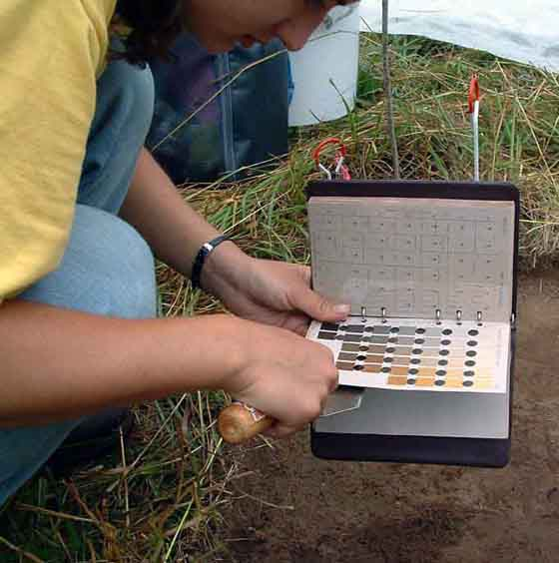
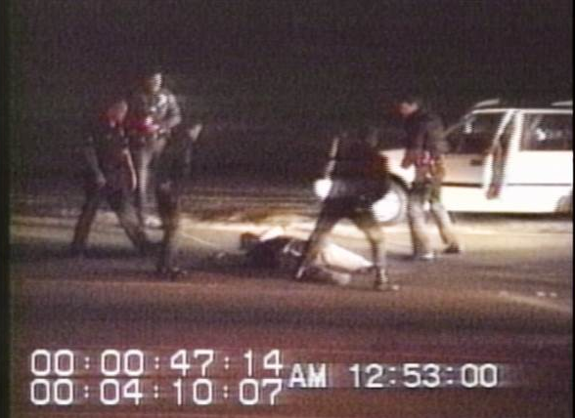
Archeology to Law: coding (data set), highlighting, representing

Slide 6
Archeology to Law: coding (data set), highlighting, representing
Rodney King incident & LA riots
March 3, 1991, Los Angeles, California: African-American motorist Rodney King is pulled over for traffic violation and beaten by group of police officers.
George Holliday’s video recording of the Rodney King beating was a centerpiece of the subsequent trial. When officers were found not guilty in the face of the video, the ruling sparked the 1992 L.A. riots.
Footage

Slide 7
Goodwin’s Professional Vision
-- Main argument?
-- Goodwin argues that the ability to discern (see) the things that matter in any profession is not a natural psychological ability, but rather an ability that emerges from the discursive practices by which professionals demonstrate competence in their profession. He claims that the competent use of these discursive practices (esp. coding, highlighting & representing) allows archeologists, lawyers, and police to see and help others see the phenomenal objects of interest in their profession.
-- One example of this from the text or one quote?
-- Coding schemes, e.g. Munsell color chart for archeologists
-- What might Goodwin say about communication, the person & everyday life?
-- Relevant features of personhood are not given as natural facts but emerge from discursive practices relevant to any situated interaction in which personhood is at issue for participants. Discursive practices (communication) include ways of speaking, gesture, position, but also rules, codes, and instructions… anything that is mutually available and relevant to members of interaction!

Slide 8
Goodwin’s methods to look at situated practices of archeology & court
Ethnography at a field school for archaeologists, observing sense-making practices taught to students through extended participation in their community
Conversation analysis (discourse analysis) of King trial, especially observing sense-making of video footage. CA focuses on actors’ own categories and meaning making.

Slide 9
Discursive practices at two sites:
How does coding, highlighting & representing happen in archeology? In court?

Slide 10
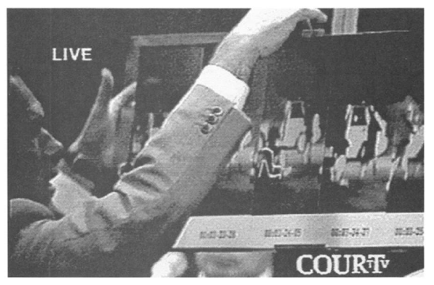
Expertise and contesting professional vision
-- Who can take on an expert role? What sorts of experience can be represented by professional expertise?
--What does this mean for contested vision?

Slide 11

Contested vision in Anna Deavere Smith’s Twilight Los Angeles
”In the 1992 trial of four white police officers charged with beating Mr. Rodney King, an African-American motorist who had been stopped for speeding, a videotape of the beating became a politically charged theater for contested vision.” (Goodwin, p.606)
Anna Deavere Smith: Actress, playwright, educator, developed Documentary Theater approach
-- an embodied, performance approach to ethnography, & an ethnographic approach to performance
-- conducts 100s of interviews, records audio, & reperforms in a one-woman show
-- “I know America by becoming America.” – performance as situated analysis
-- how is ADS’ performance ethnography a way to understand situated practices and POVs?
-- for who? -- whose practices? -- partial & contested views

Slide 12
This week’s essay question
“Goodwin’s Professional Vision analyzes different readings of the video of Rodney King being beaten by police in Los Angeles, in terms of the way police and court experts coded, highlighted and represented the beating of King. Use Butler’s theory of performativity (and its moves of citation, iteration, materialization, performative and sedimentation) to analyze the actual courtroom practices of police & law officials that Goodwin describes.”
Helpful hint – your response should include:
-- description of the specific action or scene in courtroom
-- how Goodwin interpreted this
-- how Butler can interpret same thing (using terms above)

